Slide 1
HTML5/CSS Workshop
DAY ONE

Slide 2
Who am I?
Kai Hong
ICTSE Student at SIT@Dover
KaiHong.Koh_2015@SIT.singaporetech.edu.sg
Programmer
Designer
Blogger

Slide 3
Who IS HE?
Kiang Hong
ICTSE Student at SIT@Dover
KiangHong.Law_2015@SIT.SingaporeTech.edu.sg
Programmer
Helpful person

Slide 4
webchat.freenode.net
NICKNAME: your_name
CHANNEL: htmlrocks
Verify that you’re not a robot

Slide 5
Learn what
Understand HTML/CSS
Design simple webpages
Edit templates
Create your own portfolio
Notes:
Ask if anyone of them have done this before or not
Ask them what they want to take away from this
Time to use the IRC channel
Tell them what they going to learn instead

Slide 6
Go to this address
IP_ADDRESS:8000
Download the zip file
Notes:
Download materials from simple python server

Slide 7
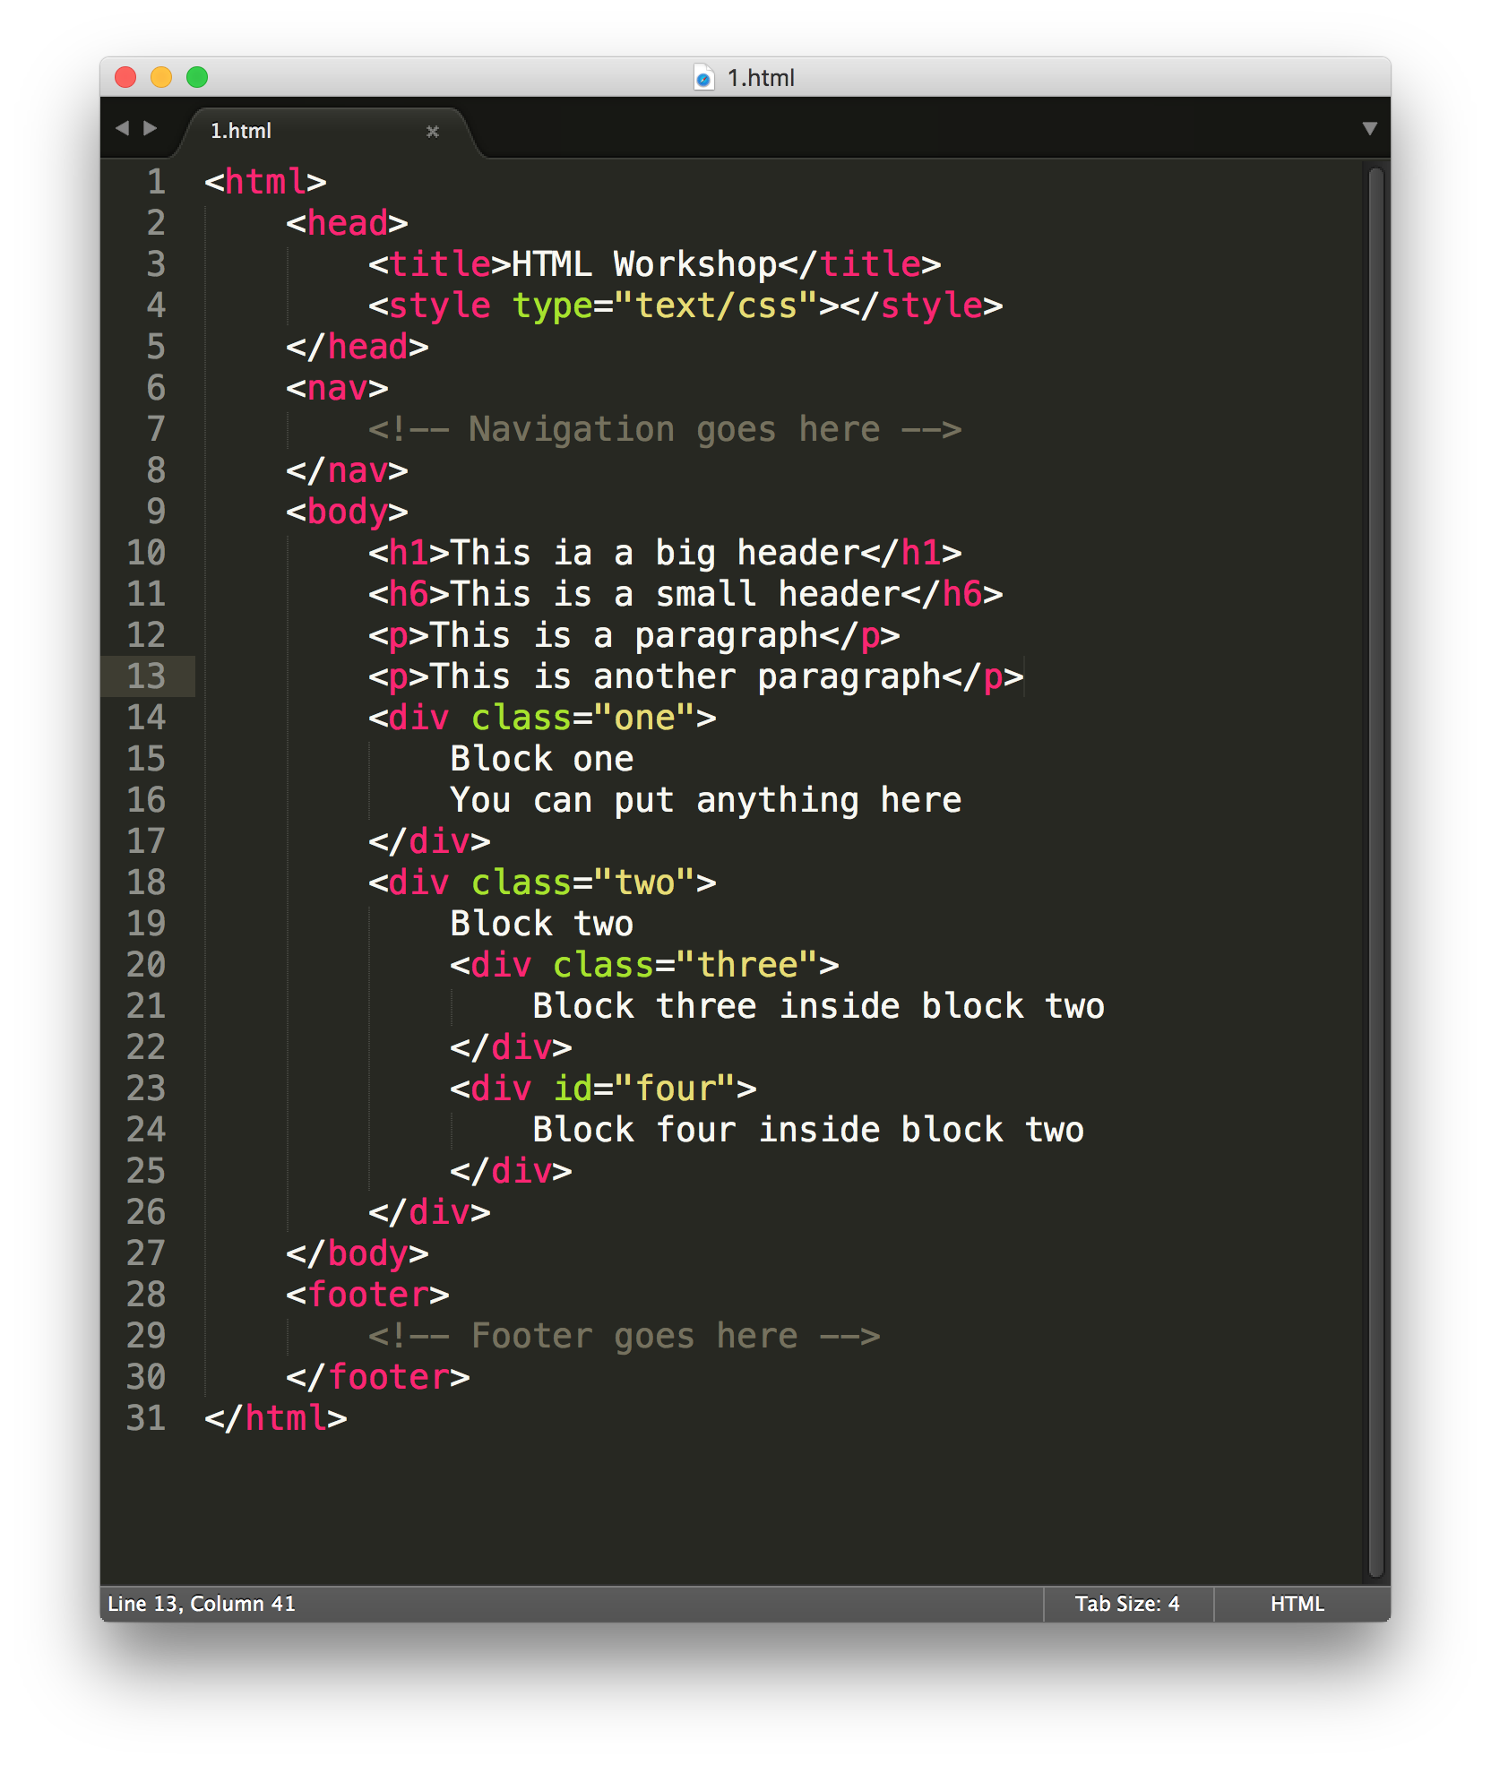
What is html?
Hyper Text Markup Language
Notes:
Briefly show them that there’s nothing to fear about HTML
Very simple

Slide 8
What is it for?
Display static web content only
Not for styling
Not for dynamic content
Not responsive
Notes:
Keep their expectations real
The advance stuffs comes later ownself need to study

Slide 9
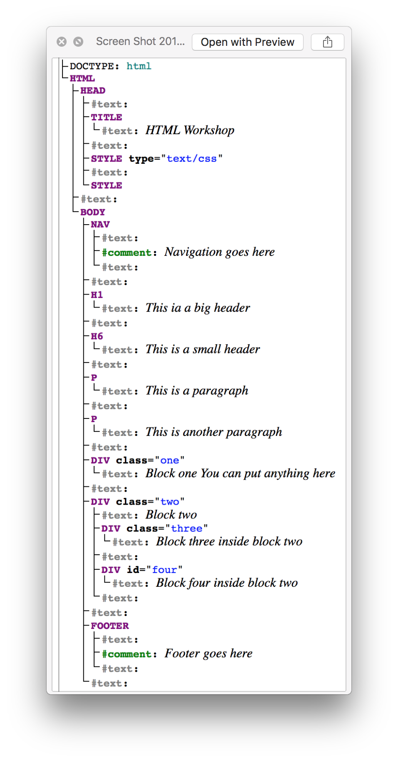
Dom tree
Document object model
Notes:
Briefly talk about DOM tree and the structure of the HTML nodes

Slide 10
syntax
How to code
<OPENING TAG>
</CLOSING TAG>
Notes:
In this workshop, you will learn about the different types of tags and how to use them

Slide 11
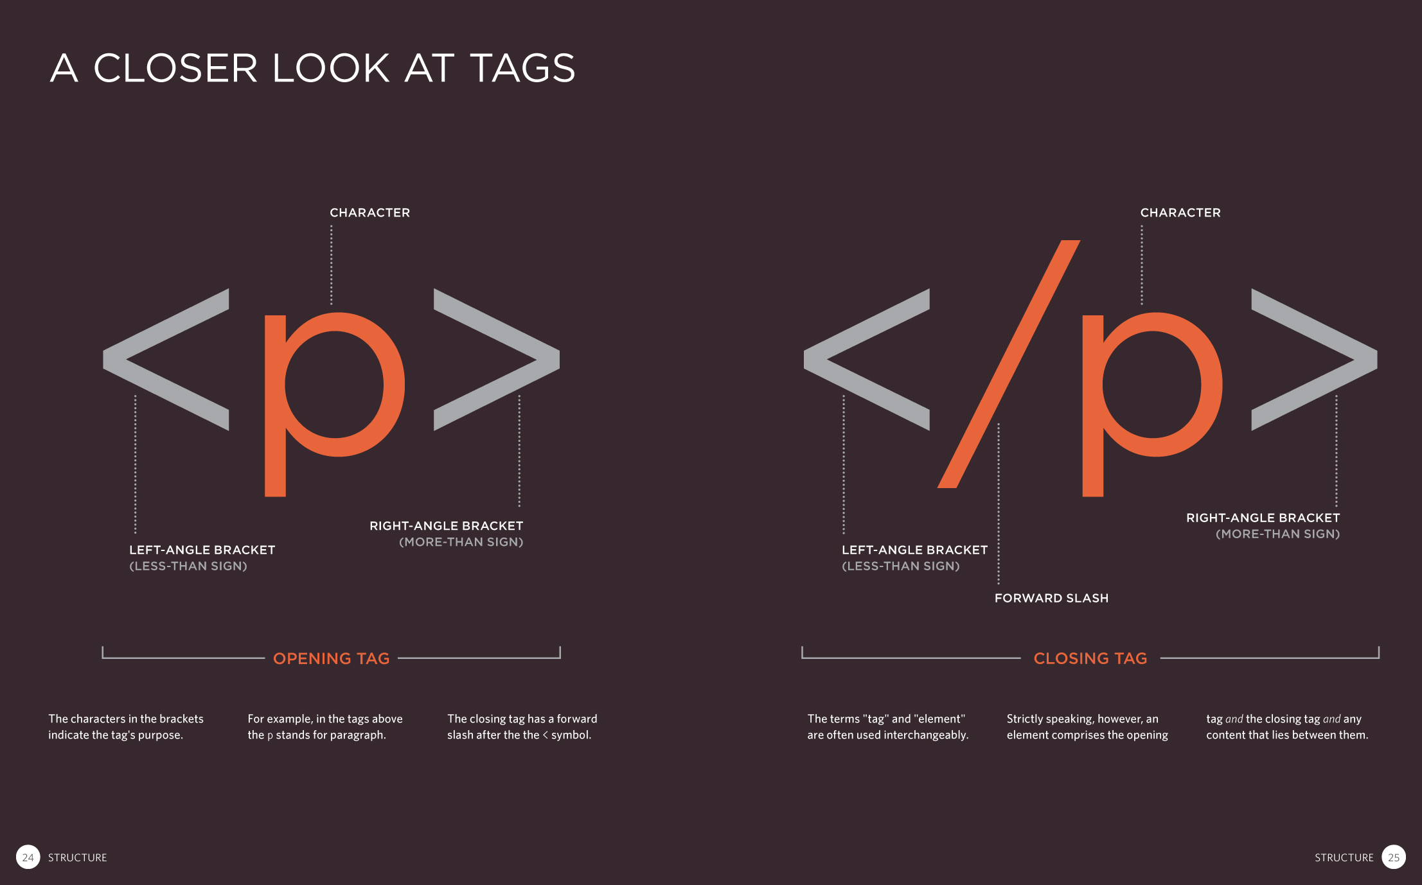
Notes:
Explain about the tags in detail

Slide 12
http://www.w3schools.com/html/
Everything that you need to know about HTML can be found here
Notes:
All the extra info and good practices can be found here

Slide 13
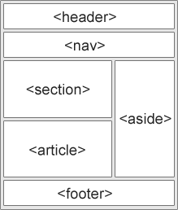
Html5 semantics
<header>
<nav>
<section>
<article>
<aside>
<footer>
<figure>
<figcaption>
Notes:
HTML5 semantic
Guideline to follow but don’t have to be too strict about it

Slide 14
OPEN FILE ONE
Let’s get started with the basics
Notes:
All the extra info and good practices can be found here

